Slide 1






Responsive Web Design
IT 4213 Mobile Web Development
IT 4403 Advanced Web and Mobile Applications
Jack G. Zheng
Spring 2020
https://www.edocr.com/v/yxdmelxy/jgzheng/responsive-web-design

Slide 2
Overview
This lecture notes summarize basic approaches to develop and deliver mobile websites, with a particular focus on responsive design.
Two (or four including subcategories) basic approaches
Separate mobile site
One web
Responsive web design
Adaptive (dynamic serving)
Hybrid: RESS (Responsive + Server Side Components)
Responsive web design principles and key practices
Fluid-grid
Fluid image/media
Media query
2

Slide 3
Mobile Website Delivery Strategies
Separate mobile version site
Separate mobile site has its own domain and address, and is independent from the main site.
One Web
One Web means making, as far as is reasonable, the same information and services available to users irrespective of the device they are using, but with different presentations (UI)

Slide 4

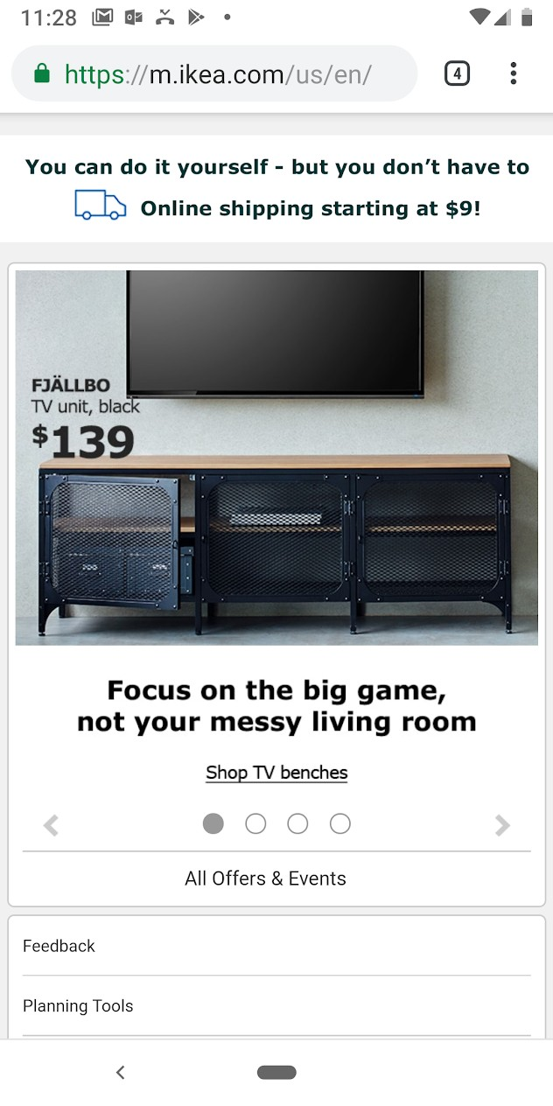


Separate Mobile Site
Separate mobile site has its own domain and address, and is independent from the main site.
A separate mobile site can best meet mobile user experience. Build a separate mobile-optimized design (or mobile site) if you can afford it.
https://www.nngroup.com/articles/mobile-site-vs-full-site/
Some examples:
Wikipedia: https://en.m.wikipedia.org
Goodwill: https://mgwdonate.ging.org (used a third party service, more like an app)
Some companies has moved away from separate mobile site, such as
Costco (m.costco.com)
Walmart (mobile.walmart.com)
Ebay (m.ebay.com)
Newegg: (m.newegg.com)
Ikea: m.ikea.com/us (jQuery Mobile)
Nike: m.nike.com
Staples: m.staples.com
Extended reading: Why Separate Mobile & Desktop Web Pages? http://www.lukew.com/ff/entry.asp?1390
4

Slide 5
One Web
Quotes from https://www.w3.org/TR/mobile-bp/#OneWeb
One Web means making, as far as is reasonable, the same information and services available to users irrespective of the device they are using, but with different presentations (UI)
It does not mean that the content is available in exactly the same representation across
all devices.
The context of mobile use, device capability variations, bandwidth issues and mobile network capabilities all affect the representation.
One Web approaches
Responsive web design (response to screen size)
Adaptive (dynamic serving based on device detection and adaptation)
Hybrid: RESS (Responsive Design + Server Side Components) http://www.lukew.com/ff/entry.asp?1392
Key readings:
Design for multi-screen experiences https://www.thinkwithgoogle.com/articles/building-websites- multi-screen-consumer.html
https://www.wired.com/2013/05/the-two-flavors-of-a-one-web-approach-responsive-vs-adaptive/

Slide 6
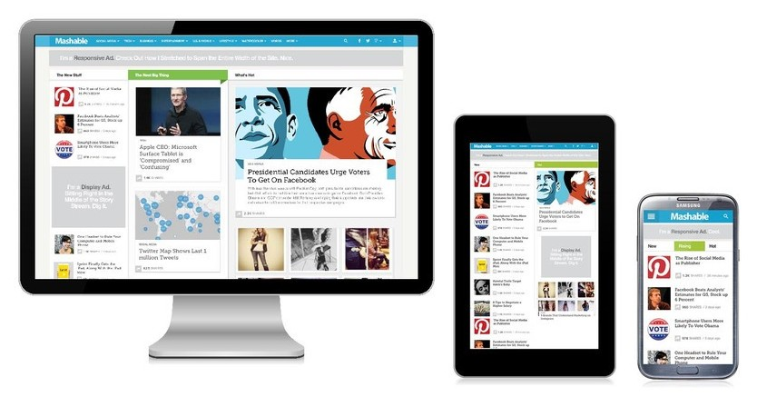



Responsive Web Design
Responsive Web Design (RWD) is a Web design approach aimed at crafting sites to provide an optimal viewing experience, easy reading and navigation with a minimum of resizing, panning, and scrolling, across a wide range of screen sizes and devices.
Ethan Marcotte coined the term responsive web design and defined it to mean fluid grid/ flexible images/ media queries in a May 2010 article in A List Apart
– http://alistapart.com/article/responsive-web-design
Basic principles and practices
Fluid grid - no horizontal scrolling
Adaptive/flexible image
Media query
Some interesting infographics about RWD https://www.webfx.com/blog/web-design/infographics- learn-responsive-web-design/

Slide 7



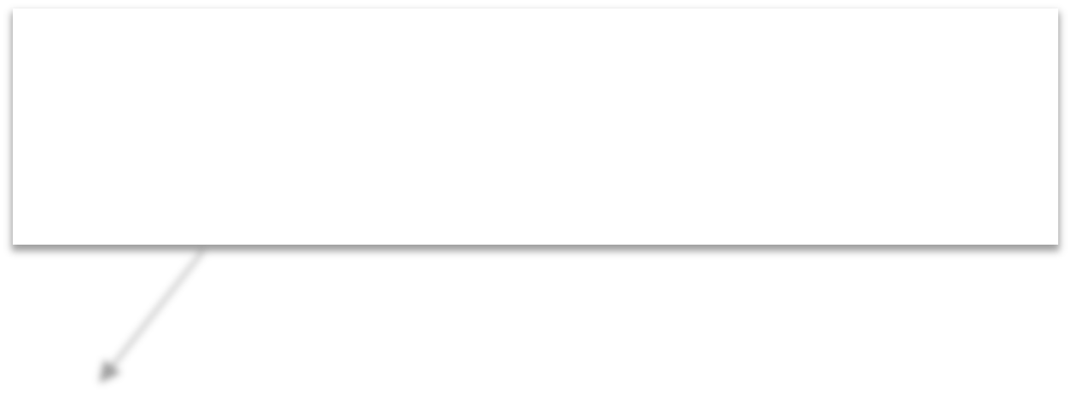


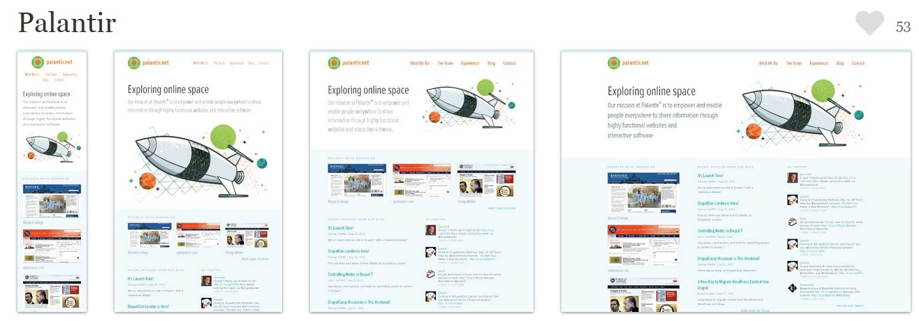
Examples
responsinator.com
Responsive examples
http://kennesaw.edu
https://cobbcounty.org
http://mashable.com
http://mediaqueri.es (more examples here)
See the webpage layout and content changes as the page width changes. The example is from https://mediaqueri.es
Non-responsive examples
https://www.weather.gov (not mobile friendly)
http://yahoo.com (adaptive but not responsive)
See more: http://cubicle-h.blogspot.com/2018/08/website-mobile-friendliness-testing.html

Slide 8
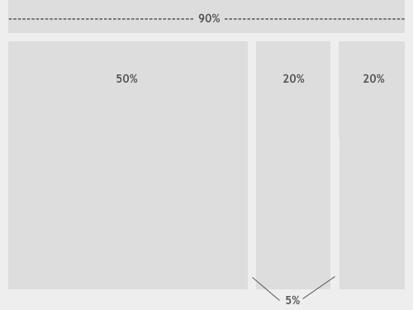
Fluid Layout
Fluid layout, is the practice of building the layout of a website capable of dynamically resizing to any width.
using relative length units, most commonly percentages or em units.
Set the width using %
Set margin and padding using %
Formula
result (%) = target / context (parent size)
This may not look optimal in some cases especially for margins and paddings. Use it together with media queries.
Other practices
Set max-width and min-width
Extended reading: https://alistapart.com/article/fluidgrids and the example https://alistapart.github.io/code-samples/fluidgrids/examples/grid/final.html
8

Slide 9



Adaptive Image
Apply similar fluid practices to images using percentages
Code example: https://www.w3schools.com/css/tryit.asp?filename=tryresponsive_image2
The image can be scaled up to be larger than its original size, which makes the image blurry. A better solution, in many cases, will be to use the max-width property.
See this example: https://www.w3schools.com/css/tryit.asp?filename=tryresponsive_image (and compare to the prior example)
img
{
display: block; max-width: 100%;
}
Don’t forget the max-width property, which limit the image size to its original size.
Reference: https://www.w3schools.com/css/css_rwd_images.asp
Take it to another level with media queries http://responsiveimages.org
9

Slide 10
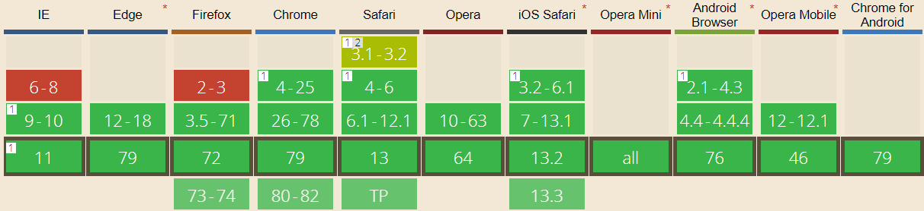
Media Query
Media query is a CSS3 module allowing content rendering to adapt to conditions such as screen resolution.
A W3C recommended standard (June 2012)
https://www.w3.org/TR/css3-mediaqueries/
A cornerstone technology of responsive web design
All major browsers support it
http://caniuse.com/#feat=css-mediaqueries

Slide 11






Media Query Basics
Media queries are based on rules (contexts) when a set of CSS should be applied
Code example
– Setting a context in CSS (<style>) block
@media screen and (max-width: 300px)
{
div {background-color: lightblue;}
}
Media features
– Setting a context in a linked CSS file
<link rel="stylesheet" type="text/css" href="..." media="screen and (max-width: 300px)" />
Three parts in any context
Media type: type of presentation media, like “screen”
Media features: specify the characteristics of media type, like “width”
Logical operator: combine multiple rules

Slide 12
Media Types and Media Features
Media Queries Level 4 defines four media types
Media Type | Description
all | Used for all media type devices
print | Used for printers
screen | Used for computer screens
speech | Used for devices that “read out” a page
Major media features
width (max-width, min-width)
aspect-ratio
orientation
resolution
For a full list of types and features, refer to:
https://developer.mozilla.org/en- US/docs/Web/CSS/Media_Queries/Using_media_queries
http://www.w3schools.com/cssref/css3_pr_mediaquery.asp

Slide 13
Logic in Media Queries
And
@media (min-width: 600px) and (max-width: 800px)
Or
@media (max-width: 600px), (min-width: 800px)
Not
@media not screen and (color)
See more here
http://css-tricks.com/logic-in-media-queries/
https://developer.mozilla.org/en- US/docs/Web/Guide/CSS/Media_queries

Slide 14
Media Query Practical Examples
When the width is between 400px and 600px on screen
@media screen and (max-width: 600px) and (min-width: 400px)
When the screen is in portrait orientation and width is less than 640px
@media screen and (max-width: 640px) and (orientation: portrait)
When the screen is narrower than 16:9 aspect ratio and the width is between 480px and 960px
@media screen and (max-width: 960px) and (min-width:480px) and (max-aspect-ratio:16/9)
Use the following web app for quick testing: https://www.w3schools.com/cssref/tryit.asp?filename=trycss3_media2

Slide 15
Identifying Media Query Breakpoints
Properly set the breakpoints of media queries to allow best viewing and interaction experience based on viewport width.
Some recommend a common set of breakpoints, such as 576, 768, 992, 1200 (Bootstrap).
Some (http://bradfrost.com/blog/post/7-habits-of-highly-effective- media-queries/) do not recommend to write media query breakpoints around common viewport sizes as determined by different device resolutions. New devices and resolutions are being released all of the time. Trying to keep up with these changes could be an endless process. Recommendations:
Create breakpoints based on content, never on specific devices, products, or brands.
Breakpoints should only be introduced when a website starts to break, look weird, or the experience is being hampered.
Pick minor breakpoints when necessary in additional to major layout changes.

Slide 16
Arrange a Set of Media Queries
Media queries are commonly used to set contexts for different sizes of screens, based on the width property
How to arrange media query contexts? There are mainly two approaches:
Graceful degradation
Mobile first or progressive enhancement
Extended reading: Generic First https://www.smashingmagazine.com/2018/12/generic-css-mobile-first/

Slide 17







Graceful Degradation
Define the default styles for large screen first.
Then use a set of rules with max-width (in descending order) for smaller screens by order.
/* Default styles first for the largest screen; then media queries for smaller screens */
...
Normal CSS styles applied
@media screen and (max-width: 1400px) {...} @media screen and (max-width: 1000px) {...} @media screen and (max-width: 600px) {...} @media screen and (max-width: 400px) {...}
Later rules override prior rules so you don’t need to redefine every CSS style. Only override those needed to be changed.

Slide 18

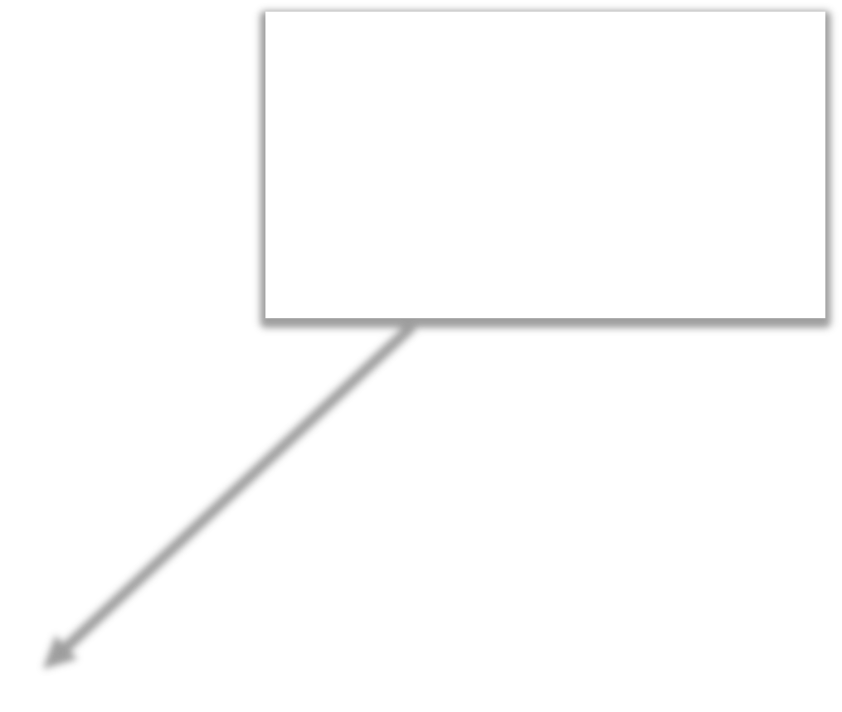







Mobile First (Progressive Enhancement)
Starts from default styles for the smallest screen.
– “The absence for @media queries is in fact the first @media query."
Then use a set of rules with min-width (in ascending order) for larger screens.
An example:
– http://zellwk.com/blog/how-to-write-mobile-first-css/
Use ascending min-width property to “grow” the width
/* Default styles first for the smallest screen; then media queries for larger screens*/
...
@media screen and (min-width: 400px) {...} @media screen and (min-width: 600px) {...} @media screen and (min-width: 1000px) {...} @media screen and (min-width: 1400px) {...}
Default CSS styles first for the smallest screen; then media queries
Later rules override prior rules

Slide 19
Mobile First
Mobile First is a philosophy created by Luke Wroblewski that highlights the need to prioritize the mobile context when creating user experiences.
Design for the smallest mobile device first; then progressively enhance the experience as more screen real estate becomes available.
Allows websites to reach more people
Forces designers to focus on core content and functionality (What do you do when you lose 80% of your screen real estate?)
Let designers innovate and take advantage of new technologies (geolocation, touch events and more)
http://www.lukew.com/presos/preso.asp?26
Extended readings
mobile-first responsive web design http://bradfrostweb.com/blog/web/mobile-first-responsive-web-design/
A Hands-On Guide to Mobile-First Responsive Design https://www.uxpin.com/studio/blog/a-hands-on-guide-to-mobile-first-design/

Slide 20
Media Query on Mobile Devices
To make media query correctly recognize the width condition on mobile browsers, viewport needs to be correctly set using the viewport meta tag. Otherwise the viewport will be set at 980px by default and media query rules for smaller screens may not be triggered.
https://www.w3schools.com/css/css_rwd_vie wport.asp

Slide 21
Media Query – A Complete Example
A complete example of using media query is described by Ethan in his original article
– http://alistapart.com/article/responsive-web-design
Check out the design results (from the example above) in some basic steps. Each is becoming more responsive.
Fluid design at the beginning: https://alistapart.github.io/code-samples/responsive-web- design/ex/ex-site-flexible.html
Add a breakpoint: https://alistapart.github.io/code- samples/responsive-web-design/ex/ex-site-linearize.html
Set for smaller screens: https://alistapart.github.io/code- samples/responsive-web-design/ex/ex-site-mini.html
Set for larger screens: https://alistapart.github.io/code- samples/responsive-web-design/ex/ex-site-larger.html
Final design: https://alistapart.github.io/code- samples/responsive-web-design/ex/ex-site-FINAL.html

Slide 22
Media Query Uses and Applications
Set different display styles
Change page layout
Change appearance/style of elements like text, tables, and forms.
Set different content
Show/hide different part of the page
Use (or hide) different image background
Use different image with different quality

Slide 23
RWD/Mobile General Principles
Two key differences of mobile web use is the small screen and touch oriented operations.
Design for Small Screens: the grand general principle of small screens is to keep the page short
Most mobile websites are viewed in portrait mode with narrow width. Stretching a normal multi column webpage will make the page extra long. https://www.viget.com/articles/do- responsive-sites-have-to-be-so-tall-on-mobile/
Long stretching pages are more likely to get user lost and difficult to navigate
Design for touch friendly UI
Touch UI poses some challenges but also offers opportunities to design better interaction methods and enable additional functionalities than traditional UI.
These two principles and some best practices will be cover in module 4.

Slide 24
RWD Patterns and Best Practices
RWD can be applied to many UI elements and content types, like:
Page layout
Navigation (menu)
Content: text, table, list
Form and controls
Specific content type like data, catalog, article, dashboard, etc.
Media like image, video, gallery, etc.
Decorative elements like icon, background, etc.
More specific patterns and best practices for selected content types will be covered in later modules 5 to 9.
General patterns and best practices collection
http://bradfrost.github.io/this-is-responsive/patterns.html
https://responsivedesign.is/patterns/
http://ui-patterns.com/patterns
Dedicated sites for examples
http://mediaqueri.es
http://www.awwwards.com/websites/responsive-design/
http://responsivedesign.is/examples
https://designmodo.com/responsive-design-examples/
https://www.awwwards.com/50-examples-of-responsive-web-design.html

Slide 25
RWD Tools
Responsive design test
https://material.io/resizer/
http://www.responsinator.com
https://www.browsersync.io
http://mobiletest.me
Emulator
https://developers.google.com/we b/tools/chrome-devtools/device- mode/
https://developer.mozilla.org/en- US/docs/Tools/Responsive_Desig n_Mode
http://www.mobilexweb.com/emula tors
http://lab.maltewassermann.com/vi ewport-resizer/
Screen size detection
http://mydevice.io
http://detectmobilebrowsers.com
Screen resolution: http://www.screenresolution.org or http://www.whatismyscreenresolut ion.com
Viewport tools (device or visual viewport)
https://viewportsizer.com and https://viewportsizer.com/devices/
http://whatismyviewport.com
https://www.mydevice.io
http://lab.maltewassermann.com/ viewport-resizer/
Feature check
http://mobilehtml5.org
http://caniuse.com

Slide 26
RWD UI Frameworks
Despite the debate of using frameworks, RWD UI frameworks has been growing in popularity
http://www.smashingmagazine.com/2014/02/19/responsive- design-frameworks-just-because-you-can-should-you/
Major frameworks
Bootstrap: http://getbootstrap.com
Zurb Foundation: http://foundation.zurb.com
Skeleton: http://getskeleton.com
Sencha Touch: http://www.sencha.com/products/touch/
More comparison
http://responsive.vermilion.com/compare.php
http://www.sitepoint.com/5-most-popular-frontend- frameworks-compared
http://mobile-frameworks-comparison-chart.com
This subject will be covered in details in module 10

Slide 27
Adaptive (Dynamic Serving)
Adaptive design aims to deliver website UI (content, style, function, etc.) and user experience that adapts to the capabilities of the device/browser.
Also called dynamic serving as in https://www.thinkwithgoogle.com/marketing-resources/experience- design/building-websites-multi-screen-consumer/
Adaptation can be done either at the server side or at the client side - https://www.wired.com/2013/05/the-two-flavors-of-a-one-web-approach-responsive-vs-adaptive/
Of the Alexa 100 sites, 80% use adaptive web design in their delivery.
https://mobiforge.com/news-comment/adaptive-web-design-dominates-in-the-webs-top-brands
Some examples (notice the webpage does not respond to real-time size change well):
http://google.com
https://www.yahoo.com
http://dealnews.com
https://gillette.com
https://github.com/vmware
Responsive design can somewhat be considered as a kind of adaptive design. It adapts UI based on screen size (width mainly). But adaptive design considers more features than just screen size.
http://bradfrost.com/blog/post/the-many-faces-of-adaptive-design/

Slide 28
Feature/Device Detection
Adaptive design heavily uses feature detection and other sound progressive enhancement techniques.
These features may include
Screen size and capabilities (orientation, touch, etc.)
Device/OS type
Browser type/version
Hardware features
https://developer.ibm.com/articles/responsive-design-future/
In the separate mobile site approach, device detection is also often used to redirect users to mobile or desktop version site.
Feature detection techniques
Parsing User-Agent strings: https://deviceatlas.com/blog/user-agent- parsing-how-it-works-and-how-it-can-be-used
Using JavaScript testing: Modernizr https://modernizr.com
More resources: https://deviceatlas.com/knowledge-base

Slide 29
RESS
RESS: Responsive Design + Server Side Components
The two approaches are not mutually exclusive. Many sites combine techniques to achieve the best results.
Some techniques
A single set of page templates define an entire Web site for all devices (responsive) but key components within that site have device-class specific implementations that are rendered server side (server side components). http://www.lukew.com/ff/entry.asp?1392
Conditional loading (adaptive): http://christianheilmann.com/2012/12/19/conditional-loading- of-resources-with-mediaqueries/
Comparison of the three:
http://www.lukew.com/ff/entry.asp?1509

Slide 30
Key Readings and Learning
Approaches summary: https://www.thinkwithgoogle.com/marketing- resources/experience-design/building-websites-multi-screen-consumer/
Responsive web design
http://alistapart.com/article/responsive-web-design: the original article focused on concepts.
Good introduction with more technical details: https://msdn.microsoft.com/en-us/magazine/hh653584.aspx
Media queries: https://developer.mozilla.org/en- US/docs/Web/CSS/Media_Queries/Using_media_queries
Adaptive web design
https://www.wired.com/2013/05/the-two-flavors-of-a-one-web-approach- responsive-vs-adaptive/
https://deviceatlas.com/blog/7-myths-about-adaptive-web-design-debunked
RESS: the original article raising the idea https://www.lukew.com/ff/entry.asp?1392
Comparison: https://www.lukew.com/ff/entry.asp?1509

Slide 31
Good Resources
Influencers
https://ethanmarcotte.com
http://www.lukew.com
http://bradfrost.com
Media resources
https://alistapart.com/topic/responsive-design
https://www.smashingmagazine.com/category/responsive-web-design
https://www.smashingmagazine.com/responsive-web-design-guidelines-tutorials/
http://www.hongkiat.com/blog/tag/rwd/
Tutorials collection
https://developer.mozilla.org/en-US/docs/Web/CSS/Media_Queries
http://www.quirksmode.org/mobile/
https://designwoop.com/responsive-web-design-tutorial
http://www.hongkiat.com/blog/responsive-for-mobile-screens/
http://www.hongkiat.com/blog/responsive-web-tutorials/
https://developer.mozilla.org/en-US/docs/Web_Development/Responsive_Web_design
http://www.youtube.com/playlist?list=PLtNErhYMkHnGh691QvRtMp9jMVzpMenL5

